Slide 1


Slide 2

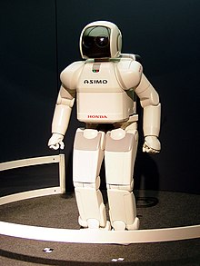
A robot is a machine—especially one programmable by a computer—capable of carrying out a complex series of actions automatically. A robot can be guided by an external control device, or the control may be embedded within.

Slide 3
Its Kinds
Autonomous robot
Human Supervised robots

Slide 4
Line Follower
The line follower robot is a mobile machine that can detect and follow the line drawn on the floor. Generally, the path is predefined and can be either visible like a black line on a white surface with a high contrasted color or it can be invisible like a magnetic filed.
Definitely, this kind of robot should sense the line with its infrared ray (IR) sensors that installed under the robot.

Slide 5
Design
Sensor as Organs
BRAIN
Actuator as Body parts that function

Slide 6
Design
That distinguish color
Microcontroller
Motors

Slide 7
Design
1.Infra red sensor
Microcontroller
(Arduino Nano)
Motors
N20 100rpm

Slide 8
Design
1.Infra red sensor
Microcontroller
(Arduino Nano)
Motors
N20 100rpm
101010
101010

Slide 9
Design
1.Infra red sensor
3
Microcontroller
(Arduino Nano)
5
Motors
N20 100rpm
2
Comparator
4
Hbridge
DRV8833

Slide 10
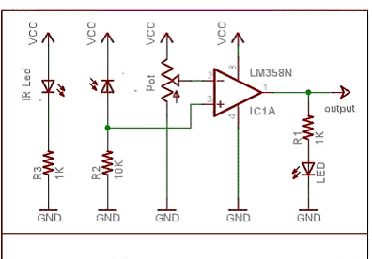
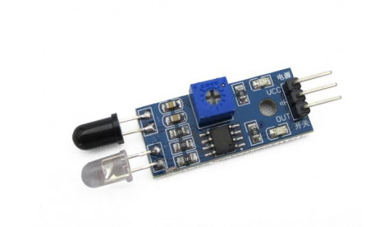
IR sensor
The circuit is quite self explanatory. The LM358 OpAmp is used in the comparator mode. The IR photodiode (receiver) is used in a potential divider in a reverse bias mode. A threshold voltage is set at the inverting terminal of the OpAmp using a potentiometer. So when the IR light reflects from a lighter surface, say white, the resistance of the photodiode would decrease and this in turn when exceeds the threshold voltage will make the output of the OpAmp go high.
LM 358 has two OpAmps in its 8 pin package, thus two sensors could be built out of 1 IC. We can also use LM 324 which has 4 OpAmps inside it

Slide 11
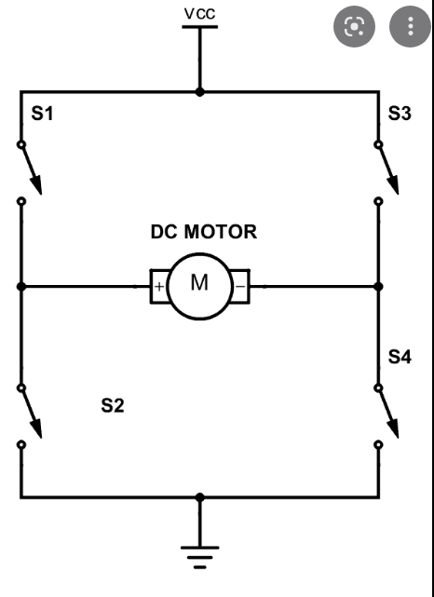
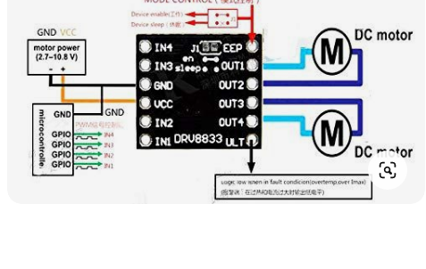
Hbridge

Slide 12
Features
DRV8833 is a dual H-bridge motor driver IC that can be used for bidirectional control of two brushed DC motors at 2.7 V to 10.8 V. It can supply up to about 1.2 A per channel continuously and can tolerate peak currents up to 2 A per channel for a few seconds, making it an ideal driver for small motors that run on relatively low voltages. The board ships populated with SMD components, including the DRV8833, and adds an FET for reverse battery protection.
The DRV8833 has a higher peak current rating (2 A per channel vs 1.5 A), optional built-in current-limiting, and no need for externally supplied logic voltage.
Features:
Dual-H-bridge motor driver: can drive two DC motors or one bipolar stepper motor
Operating voltage: 2.7V to 10.8V
Output current: 1.2A continuous (2A peak) per motor
Motor outputs can be paralleled to deliver 2.4A continuous (4A peak) to a single motor
Inputs are 3V- and 5V-compatible
Under-voltage lockout and protection against over-current and over-temperature
Reverse-voltage protection circuit
Current limiting can be enabled by adding sense resistors (not included)

Slide 13
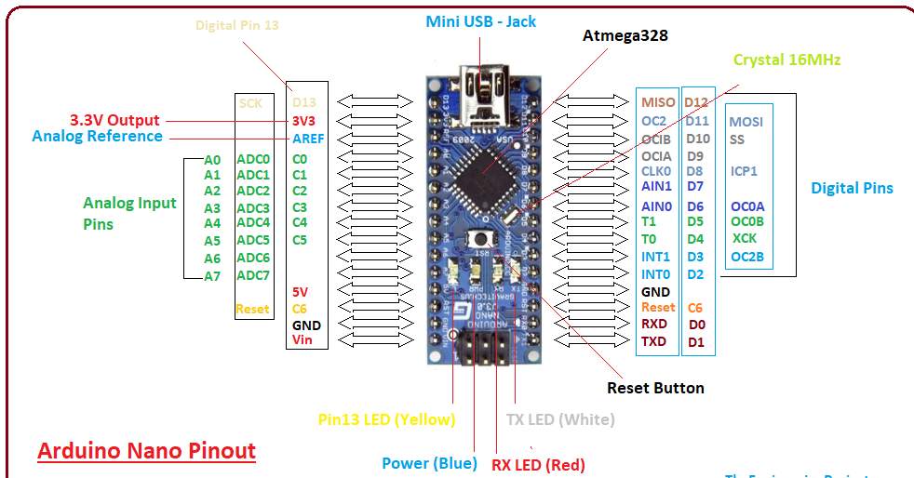
Microcontroller
It is a Microcontroller board developed by Arduino.cc and based on Atmega328p / Atmega168.
Arduino boards are widely used in robotics, embedded systems, and electronic projects where automation is an essential part of the system. These boards were introduced for the students and people who come with no technical background.
Any kind of support and help is readily available by the Arduino community that is too easy to approach and sets you free from depending on others:

Slide 14
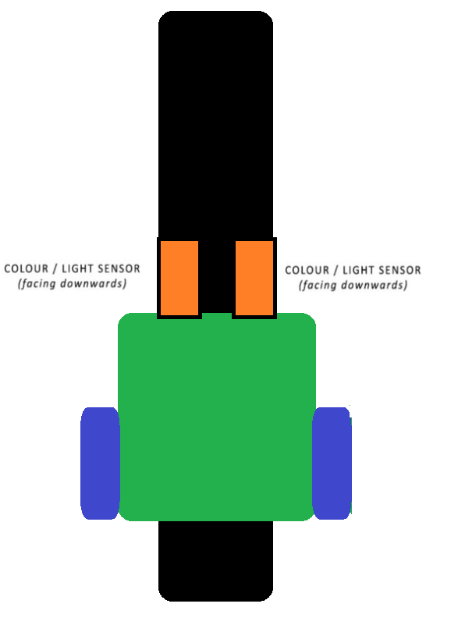
Algorithm
Conditions
Both sensors are in line.
Decision-> Both Motors run forward

Slide 15

Algorithm
Conditions
Both sensors are in line.
Decision-> Both Motors run forward.
Left Sensor out of line.
Decision-> left motor forward
Right motor stop.

Slide 16
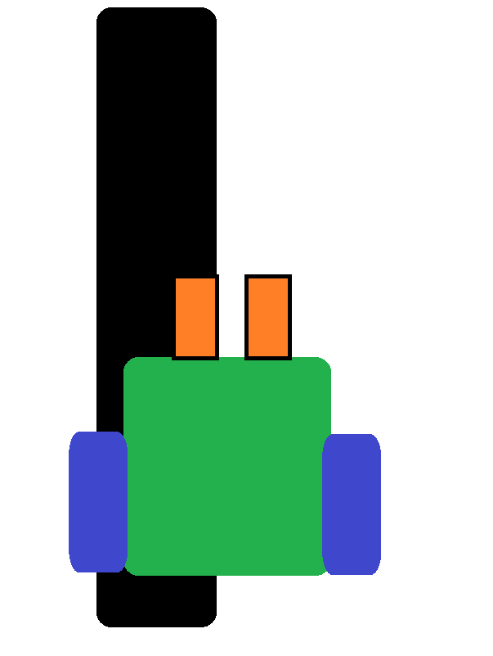
Algorithm
Conditions
Both sensors are in line.
Decision-> Both Motors run forward.
Left Sensor out of line.
Decision-> left motor forward
Right motor stop.
3. Right Sensor out of line.
Decision-> Right motor forward
Left motor stop

Slide 17
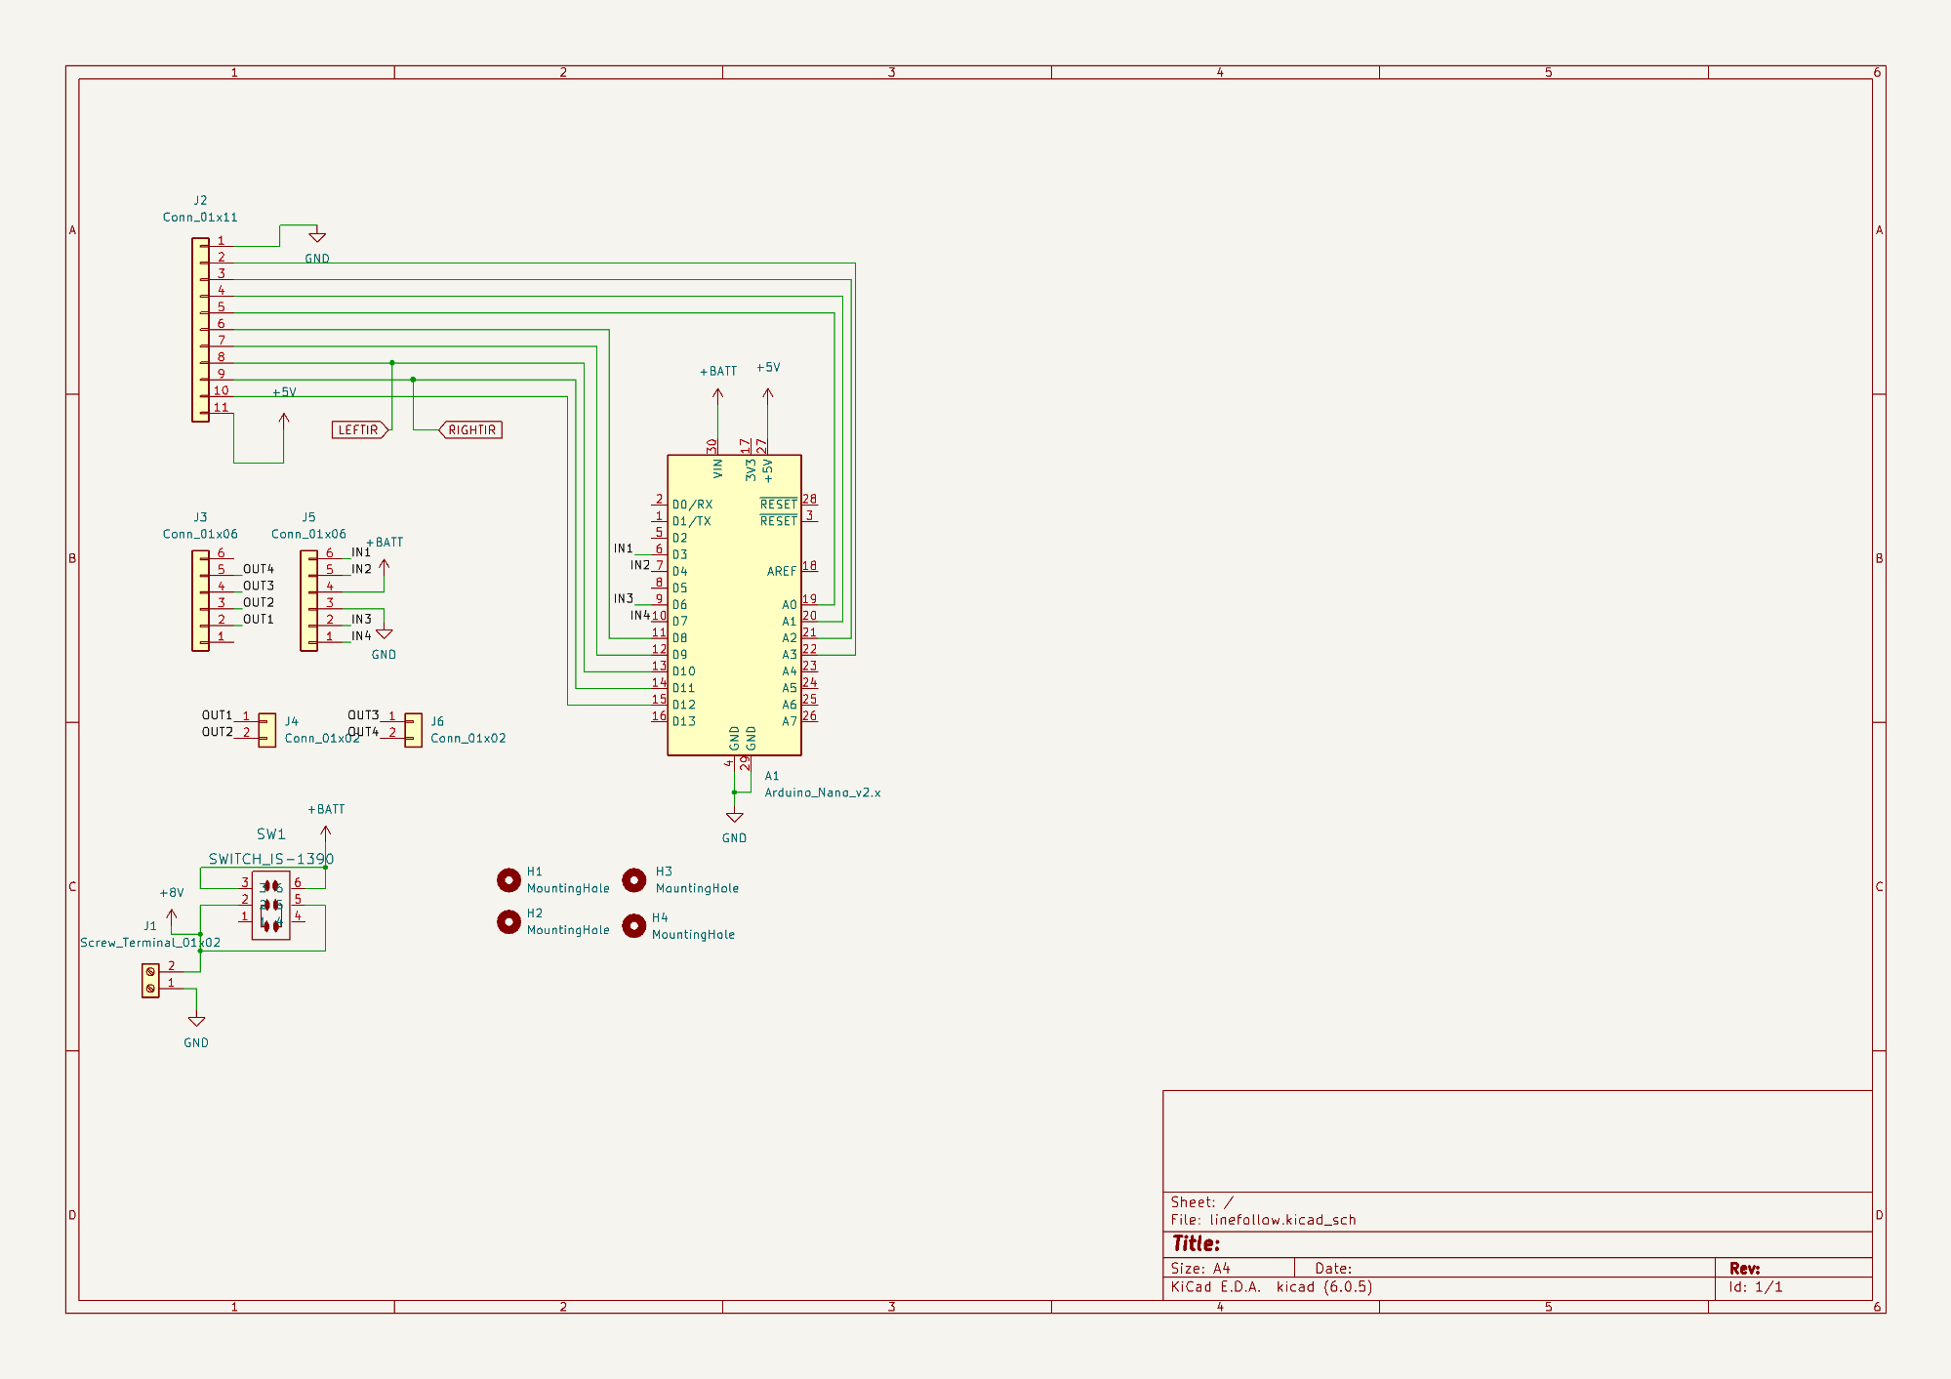
Circuit

Slide 18
Coding
void setup() {
// put your setup code here, to run once:
pinMode(3,OUTPUT);
pinMode(4,OUTPUT);
pinMode(6,OUTPUT);
pinMode(7,OUTPUT);
pinMode(8,INPUT_PULLUP);
pinMode(9,INPUT_PULLUP);
digitalWrite(3,LOW);
digitalWrite(4,LOW);
digitalWrite(6,LOW);
digitalWrite(7,LOW);
}

Slide 19
void loop() {
// put your main code here, to run repeatedly:
if(digitalRead(8)==LOW && digitalRead(9)==LOW)
{
digitalWrite(3,LOW);
digitalWrite(4,HIGH);
digitalWrite(6,LOW);
digitalWrite(7,HIGH);
}

Slide 20
Coding
else if(digitalRead(8)==LOW && digitalRead(9)==HIGH)
{
digitalWrite(3,LOW);
digitalWrite(4,HIGH);
digitalWrite(6,LOW);
digitalWrite(7,LOW);
}
else
{
digitalWrite(3,LOW);
digitalWrite(4,LOW);
digitalWrite(6,LOW);
digitalWrite(7,LOW);
}
}

Slide 21
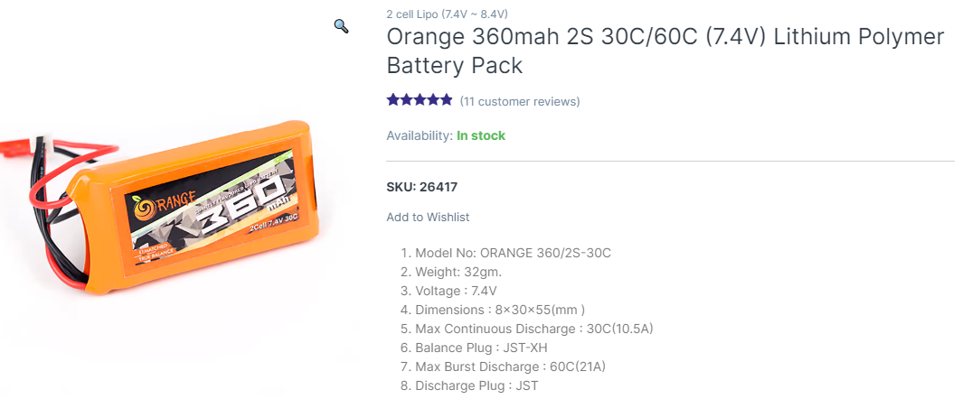
Battery

Slide 22
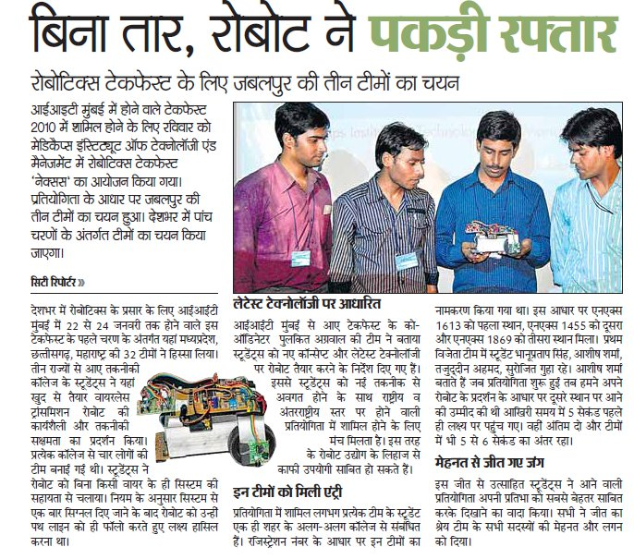
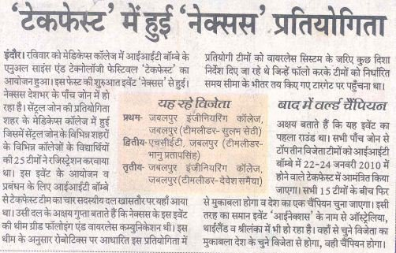
Performance

Slide 23


Performances

Slide 24

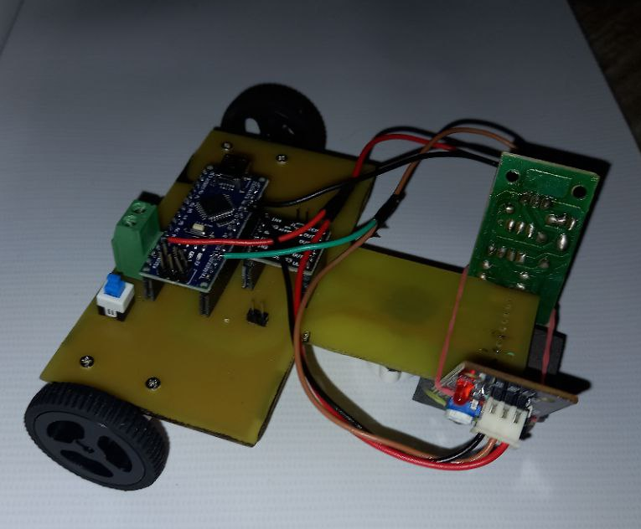
Thank You

